Slide 1

ME4030 Intro To PID Control
Micro Teaching Project Sriram Krishnamoorthy ESED 8200 – Fall 2024

Slide 2
Lesson Overview
Description Timeline Recap
Learning Objectives
Performance parameters
PID control design
PID playground
1 min
1 min
4 mins
4 mins
10 mins
Quiz
Minute paper

Slide 3

Description: This course provides an in-depth introduction to control systems engineering, focusing on modeling, analysis, and design techniques for linear feedback control systems. Intended Audience: Senior level students in ME or EE. Pre-requisites: ME 3050 (Modelling and Analysis of Dynamical Systems) or equivalent. Required Materials: Course notes (available online) and access to simulations. Suggested Materials: Nise, Norman S. Control systems engineering. John Wiley & Sons, 2020.
ME 4030 – Control and Integration of Dynamical Systems
Week 1: Modeling dynamical systems
Week 2: Laplace Transforms
Week 3: State space representation
Week 4: Time domain analysis
Week 5: Concepts of stability and feedback
Week 6: Introduction to PID control

Slide 4
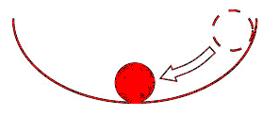
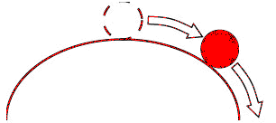
Quick Recap
Stable
What is a control system
Idea of feedback
Conditions for Stability
Unstable
Input
Error
Controller
System
Output
Feedback

Slide 5
Learning Objectives
Performance parameters
Rise time,
Settling time,
Peak overshoot,
Steady state error
1
Design a PID controller
Understand the basic components of a PID (Proportional-Integral-Derivative) controller and learn how to design one to control a simple system
2
Analyze system response
Students will be able to simulate the system with the PID controller, analyzing the system's response and the effects of tuning the PID gains.
3

Slide 6

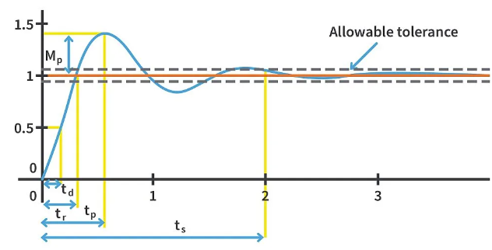
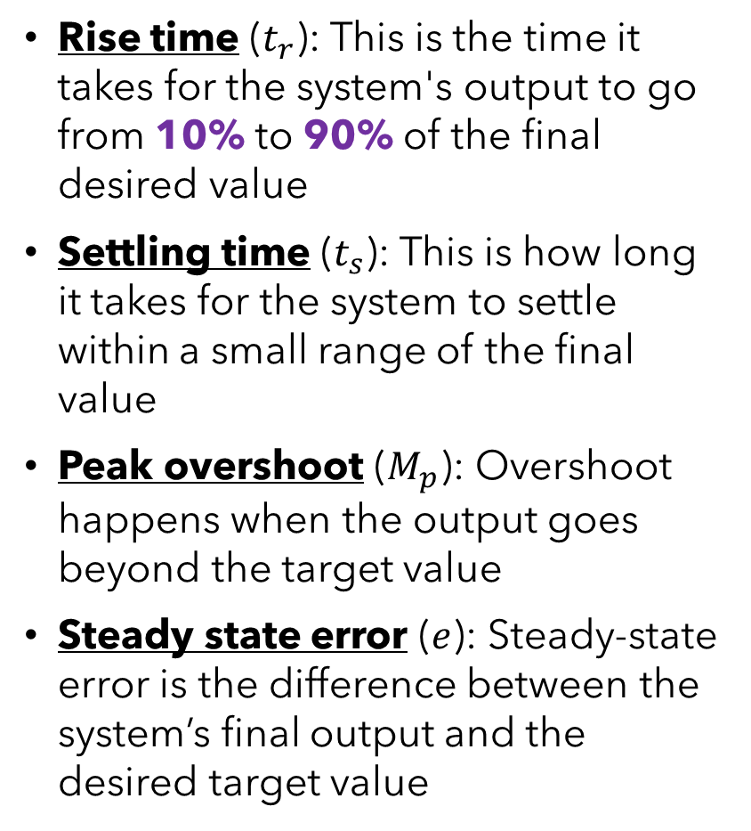
Performance parameters (4 mins)
Rise time ($t_{r}$): This is the time it takes for the system's output to go from 10% to 90% of the final desired value
Settling time ($t_{s}$): This is how long it takes for the system to settle within a small range of the final value
Peak overshoot ($M_{p}$): Overshoot happens when the output goes beyond the target value
Steady state error ($e$): Steady-state error is the difference between the system’s final output and the desired target value

Slide 7
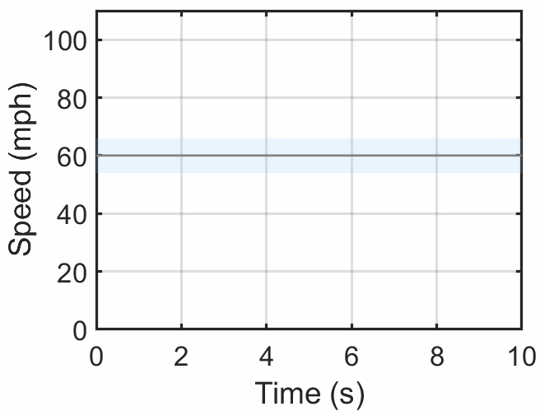
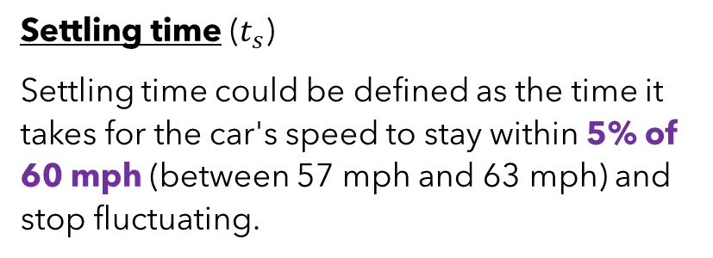
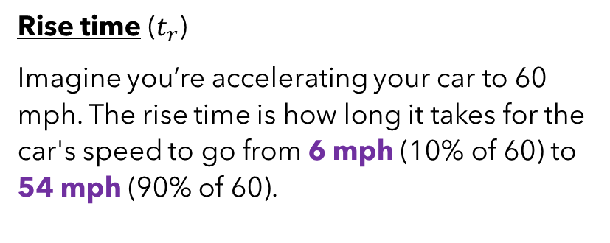
Case Study: Driving a car
Rise time ($t_{r}$)
Imagine you’re accelerating your car to 60 mph. The rise time is how long it takes for the car's speed to go from 6 mph (10% of 60) to 54 mph (90% of 60).
Settling time ($t_{s}$)
Settling time could be defined as the time it takes for the car's speed to stay within 5% of 60 mph (between 57 mph and 63 mph) and stop fluctuating.

Slide 8
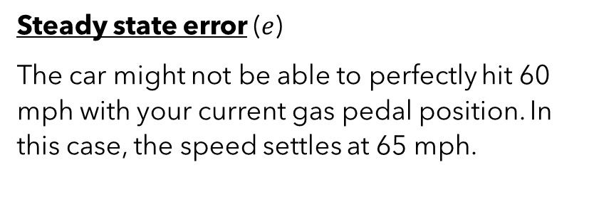
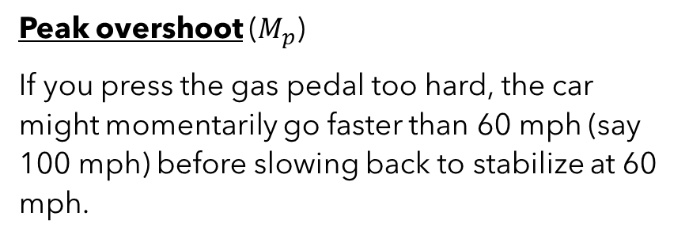
Case Study: Driving a car
Peak overshoot ($M_{p}$)
If you press the gas pedal too hard, the car might momentarily go faster than 60 mph (say 100 mph) before slowing back to stabilize at 60 mph.
Steady state error ($e$)
The car might not be able to perfectly hit 60 mph with your current gas pedal position. In this case, the speed settles at 65 mph.

Slide 9
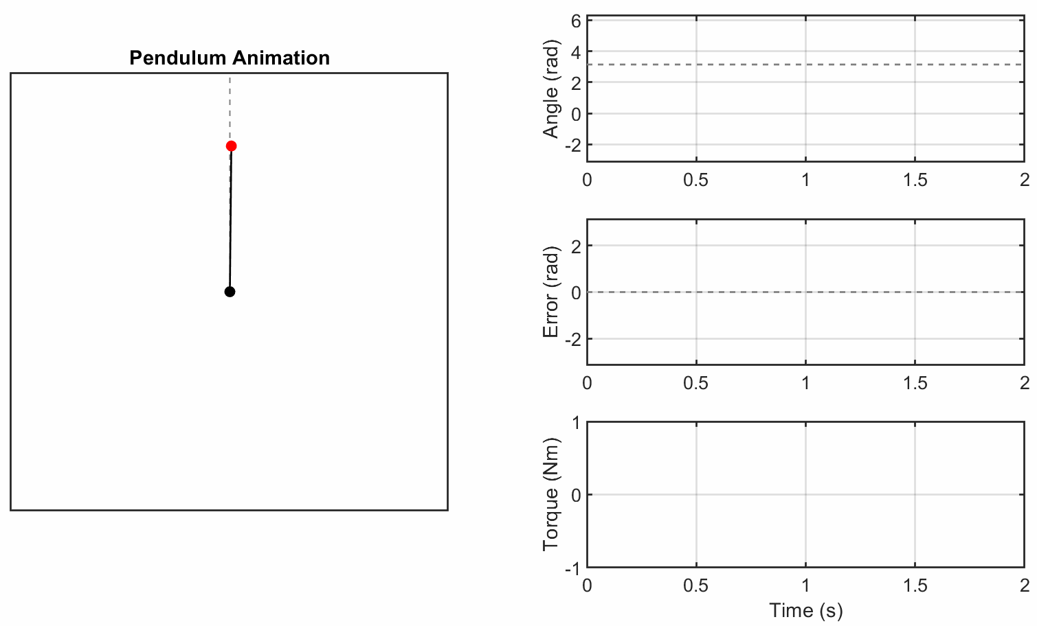


Design a PID controller (4 mins)
Proportional
Desired angle
Current angle
Error
Torque
System
Integral
Derivative
Feedback

Slide 10
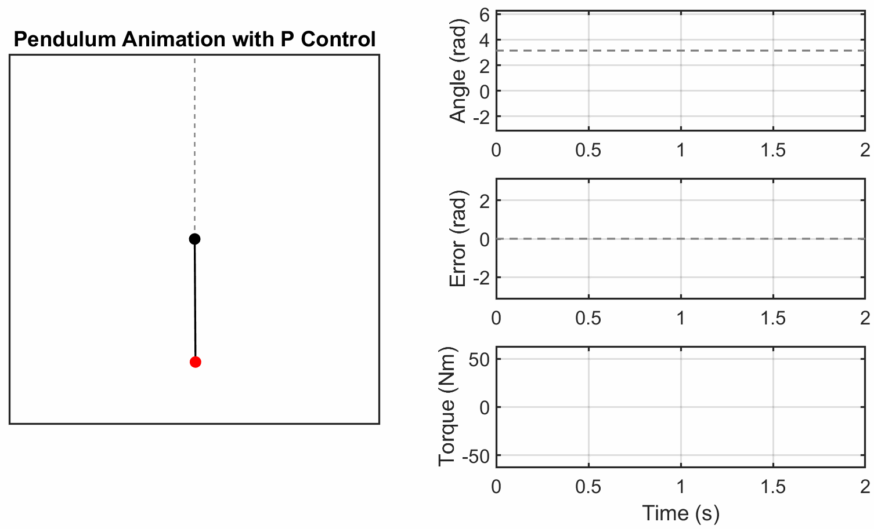
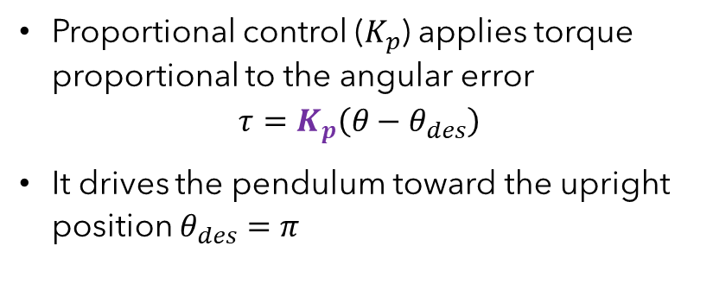
Proportional Pete
Proportional control ($K_{p}$​) applies torque proportional to the angular error
$$τ=K_{p}\left(θ−θ_{des}\right)$$
It drives the pendulum toward the upright position $θ_{des}=π$
Effect on performance parameters:
Decreases rise time
No change to settling time
Increases peak overshoot
Decreases steady state error

Slide 11
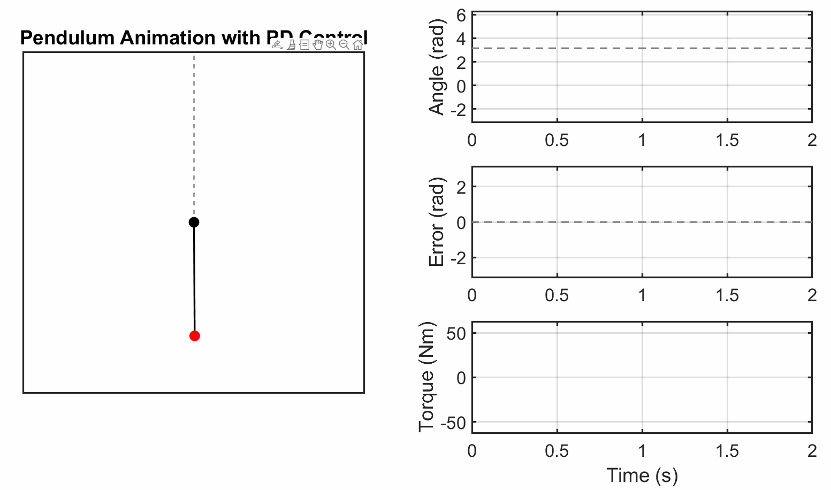
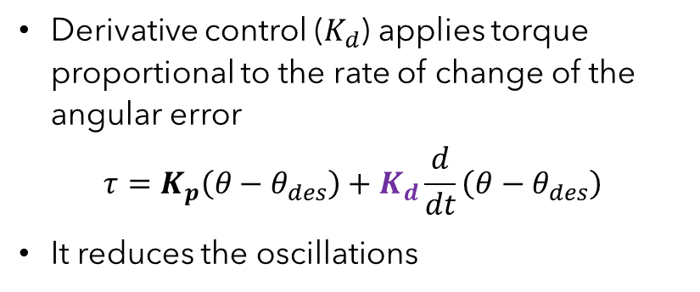
Derivative Dave and Pete
Derivative control ($K_{d}$) applies torque proportional to the rate of change of the angular error
$$τ=K_{p}\left(θ−θ_{des}\right)+K_{d}\frac{d}{dt}\left(θ−θ_{des}\right)$$
It reduces the oscillations
Effect on performance parameters:
No change to rise time
Decrease settling time
Decrease overshoot
No change to steady state error

Slide 12

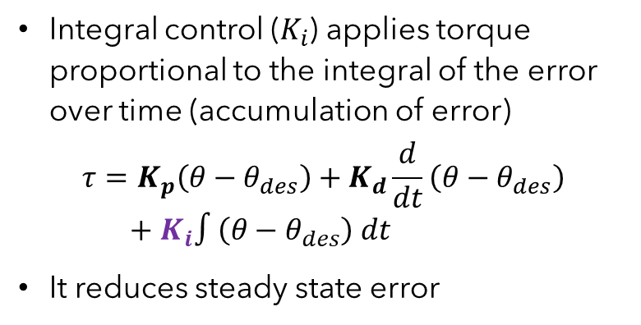
Integral Ian, Dave and Pete
Integral control ($K_{i}$) applies torque proportional to the integral of the error over time (accumulation of error)
$$τ=K_{p}\left(θ−θ_{des}\right)+K_{d}\frac{d}{dt}\left(θ−θ_{des}\right) \\ +{ K}_{i}∫\left(θ−θ_{des}\right) dt$$
It reduces steady state error
Effect on performance parameters:
Decrease rise time
Increases settling time
Increases overshoot
Decrease to steady state error

Slide 13
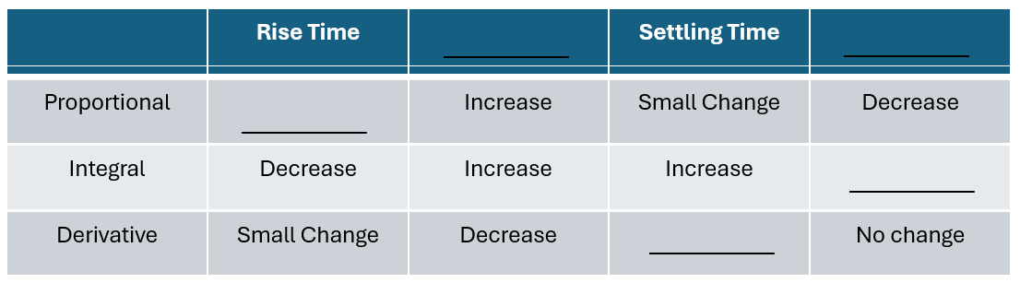
Quiz
Performance parameters:
Rise time
Settling time
Peak overshoot
Steady state error
Effects:
Increase
Decrease
Small change
No change

Slide 14
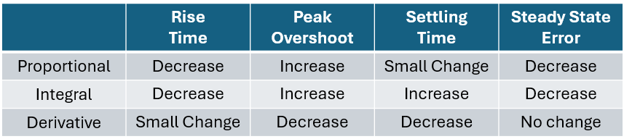
Quiz Solution
Performance parameters:
Rise time
Settling time
Peak overshoot
Steady state error
Effects:
Increase
Decrease
Small change
No change

Slide 15

PID playground (5 mins)
Open the link below on your PC to play around with the PID gains for the pendulum system.
https://tinyurl.com/pid-playground
Objective:
Try to pick gains that stabilize the pendulum in the inverted position (good controller)
Try to pick gains that destabilize the system (bad controller)
Proportional
Input
Error
System
Output
Integral
Derivative
Feedback

Slide 16
Discussions (2 mins)
Proportional Control:
What happens when we add a proportional controller to the pendulum system?
How does it affect rise time, overshoot, and steady-state error?
Derivative Control:
How does a derivative controller influence the pendulum's response?
What role does it play in damping oscillations and reducing overshoot?
Integral Control:
Why might a system need an integral controller?
What kinds of errors does it address, and what are the trade-offs of adding it?

Slide 17
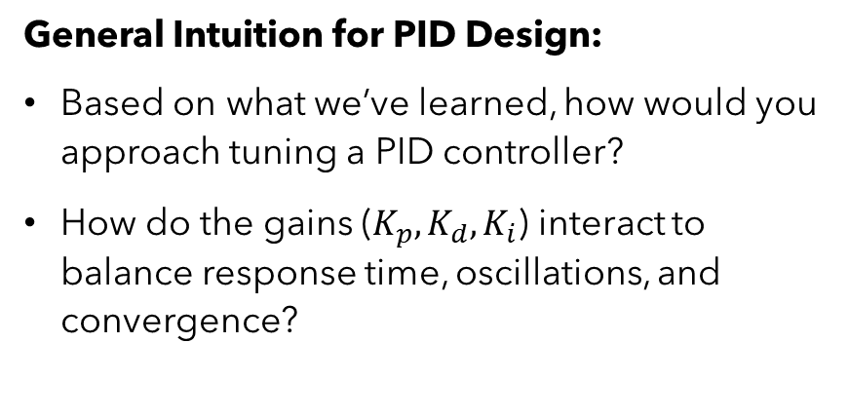
Discussions (2 mins)
General Intuition for PID Design:
Based on what we’ve learned, how would you approach tuning a PID controller?
How do the gains ($K_{p}, K_{d}, K_{i}$​) interact to balance response time, oscillations, and convergence?

Slide 18
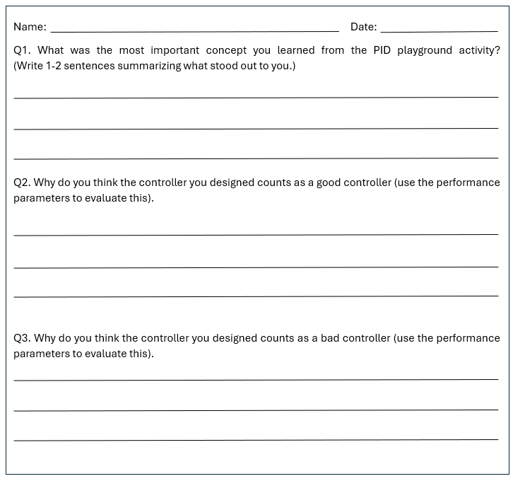
Questions?
Please fill out the minute paper before you leave class.

